Slide 1


INTRODUCTION
Presentation by:
Beau Churchill
Datasets:
Police Fatalities 1760-2023, U.S. Average Temeratures (Annual)
Date:
8/10/25
Research Questions:
What are the leading causes of officer-related fatalities?
What time of year has the highest concentration of officer-related deaths?
What day of the week has the highest concentration of officer-related deaths?
Does average yearly temperature correlate with the number of officer-related deaths?

Slide 2

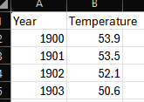
DATA CLEANING & PREPARATION
No vital NAs in either dataset (surprisingly).
In the Police dataset, there were 23,448 observations and 12 original variables (I added 3 to parse data for analysis).
The Average Weather dataset had 123 observations and 2 variables.
Had to align each dataset in terms of years. Police death records date back to the 1700s, while accurate weather records only started in the late 1800s. Aligned data in both datasets to start from 1900.
The End_Of_Watch (death date) variable needed to be reformatted to a “date” data type, rather than a “text” data type.
Data was cleaned, and variables were created in Excel before R analysis.

Slide 3
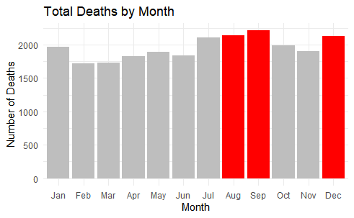
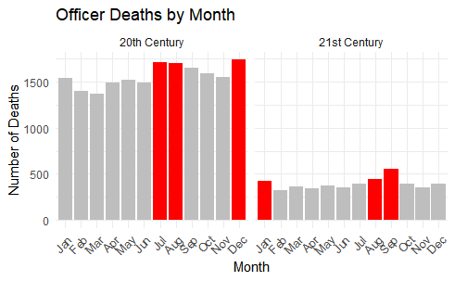

EXPLORATORY DATA ANALYSIS
Hypothesis:
Null Hypothesis (H₀): There is no significant relationship between average yearly temperature and the number of officer fatalities.
Alternative Hypothesis (H₁): Higher average temperatures are associated with an increase in officer fatalities.
EDA:
Examined trends within the police_deaths dataset.
Identified months with the highest fatality counts.
Noted that peak months align with seasonal temperature extremes — primarily summer (highest heat) and winter (coldest months).

Slide 4
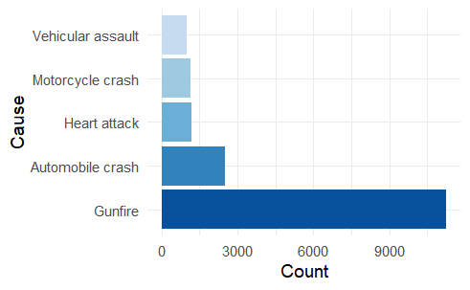
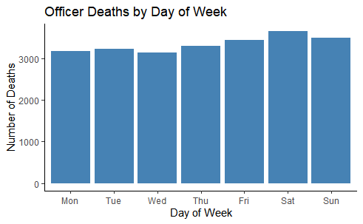

EXPLORATORY DATA ANALYSIS CONT.
Additional Explorations (Curiosity-Driven)
Day of the Week: Analyzed fatalities by day to see if certain days had higher occurrences.
Cause of Death: Identified and ranked the top 5 causes of officer fatalities.
Compared these findings across all available years to spot consistent patterns.
ShotSpotter is an acoustic gunshot detection system that uses a network of sensors to identify, locate, and alert police to possible gunfire in real time.
The MPD began using it in 2006, expanding and upgrading the system over time to improve accuracy and reduce false alerts from non-gunshot noises like fireworks

Slide 5
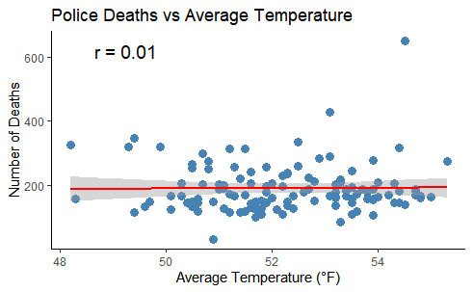
TOP THREE MONTHS
Across centuries, certain months consistently ranked highest in officer fatalities, with most deaths occurring in summer months.
DAY OF WEEK PATTERNS
Fatalities occurred on all days, with some variation in frequency across weekdays, with most deaths occurring on Saturdays.
LEADING CAUSES
Top five causes of officer deaths identified, with firearm-related incidents dominating.
KEY FINDINS AND RESULTS
CORRELATION ANALYSIS
r ≈ 0.01 - No measurable linear relationship between average yearly temperature and officer fatalities.
Conclusion: Fails to reject the null hypothesis — temperature alone does not appear to significantly impact officer deaths, at least by yearly average temperature.

Slide 6

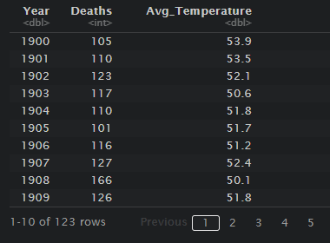
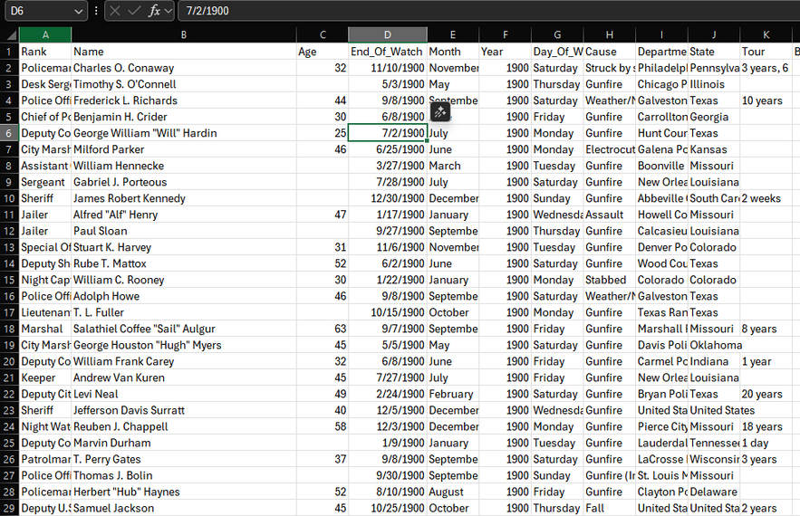
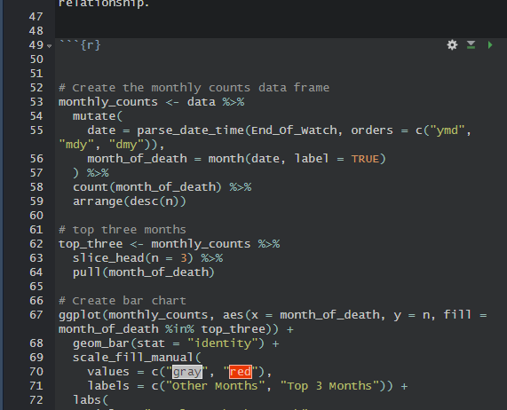
Data Availability: Could not find a reliable dataset with monthly average temperature to pair with fatality data for finer-grained analysis.
Data Parsing & Cleaning: Learned to parse dates, extract variables (year, month), and prepare datasets for analysis.
Advanced R Coding Skills: Needed to quickly learn new functions and libraries; relied on Codecademy, W3Schools, Stack Overflow for solutions - and a little Gen AI, not gonna lie ;)
Time Alignment Issues: Had to filter and align police fatality data (1700s onward) with temperature data (starting in 1900).
Working with Large Datasets: Navigating datasets with many variables and potential research questions made it challenging to focus on the most relevant ones. All your questions get answered with more questions!
OBSTACLES & CHALLENGES

Slide 7




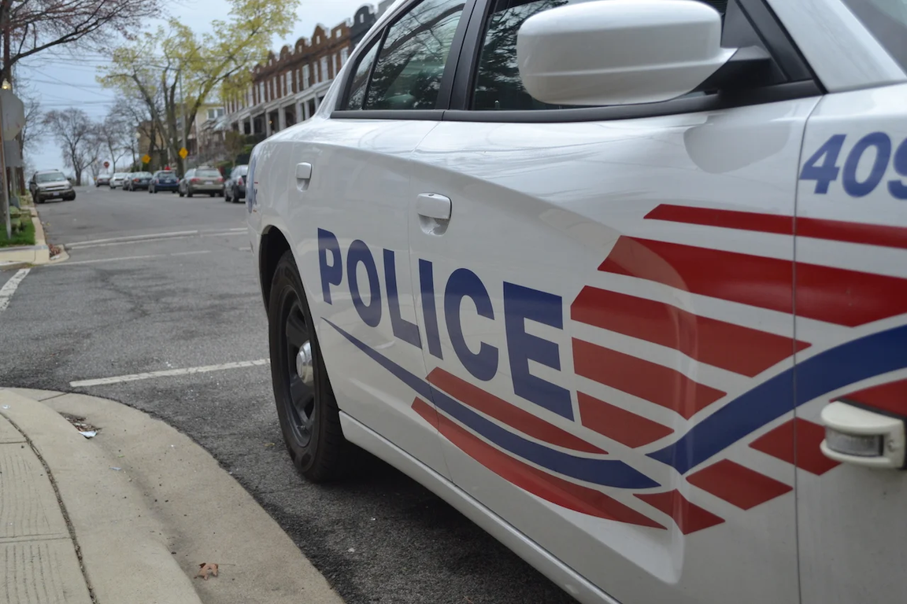
FUTURE STEPS
Obtain Finer-Grained Weather Data: Use monthly or daily temperature records to analyze seasonal or short-term effects on fatalities.
Include Extreme Weather Events: Examine the impact of heatwaves, storms, or other environmental hazards on officer deaths.
Expand Environmental Variables: Consider precipitation, humidity, or location-specific climate patterns.
Explore Additional Risk Factors: Incorporate changes in law enforcement practices, crime rates, or population density over time.
Improve Analytical Methods: Use advanced statistical modeling or machine learning to detect more complex patterns.
WHY THIS MATTERS:
Understanding patterns in officer fatalities helps law enforcement identify higher-risk times, causes, and conditions, enabling better safety strategies, resource allocation, and training to protect officers on duty.

Slide 8

THANK YOU

